Slide 1
Projects In Express
An Overview Of Passport

Slide 2
What Is Passport?
Simple, unobtrusive authentication for Node.js
Can be dropped into almost any Express app
Multiple authentication strategies

Slide 3
Passport Advantages
300+ authentication strategies
Use any database / ORM / ODM
Easily handle success and failure
Supports persistent sessions
Lightweight code base
Easily integrate Bcrypt

Slide 4
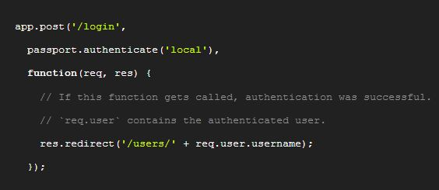
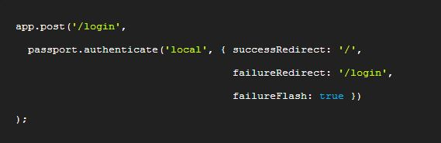
Authenticate
Call passport.authenticate() along with which strategy to employ
By default if auth fails, a 401 status will be returned
You can create additional handlers

Slide 5
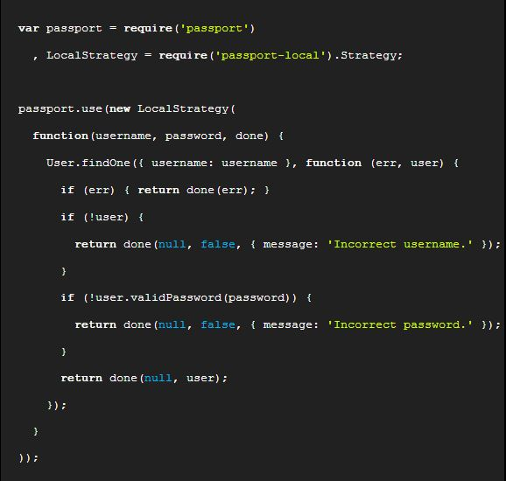
Strategies
Used to authenticate requests
Range from verifying user/pass to delegated authentication using Oauth or federated auth using OpenID

Slide 6
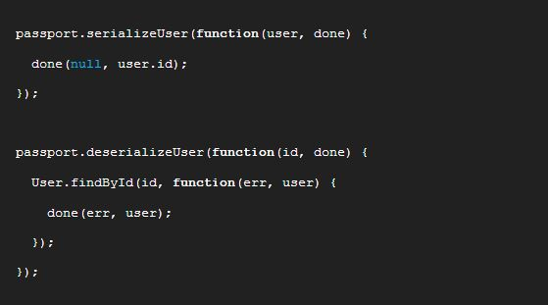
Serialization
Used to establish and maintain a session
Each request will contain a unique cookie to identify the session
Passport will serialize and deserialize user instances to and from the session.

Slide 7


